Slide 1
Unsupervised Time Series Anomaly Detection Peter Chen
Notes:
New R&D project that I recently started working on.
This project will have a lot of overlap with a masters project that I am doing for my Georgia tech master degree.

Slide 2
Project Overview
Proposal: R&D of unsupervised anomaly detection algorithms for time series data
Benchmark different unsupervised methods on open datasets
Develop methodology to analyze reconstruction error
Only results on open source datasets will be shared with Georgia Tech
Benefits
Successfully machine learning model can save millions of dollars for UTC
Common code base can be applied to various anomaly detection problems at UTC
Datasets
1. Paper Mill Failure Dataset

Slide 3
Anomaly detection
Traditional Anomaly Detection for Machine Data
Tiered alarm systems using expert set thresholds and statistical analysis of data
Challenges
Lots of manpower needed to set thresholds
Lack of failure data - class imbalance
High Dimensional – difficult to visualize
Non-stationary – changing contexts (ex. Different ambient conditions)
One size fits all thresholding technique is not ideal for non-stationary data
Potential Improvement
Unsupervised learning – Clustering/Autoencoders
Learn to model nominal behavior
Assess deviation for new data points to determine likelihood of anomaly
Notes:
Background about Anomaly Detection for machine and manufacturing data
Traditionally, Anomaly detection has been done with thresholding techniques that are tuned by domain experts and statistical analysis of data
Potential improvement is to use unsupervised learning – get a good model of nominal/non-failure behavior
Use this model to assess deviation from nominal behavior to classify data as an anomaly

Slide 4
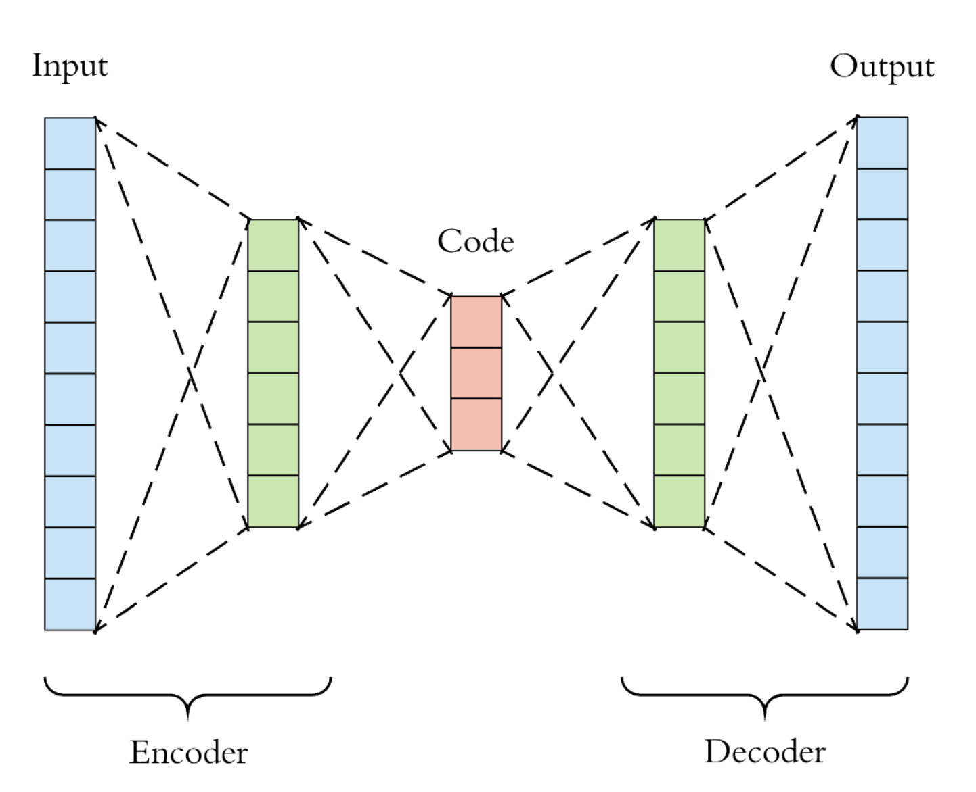
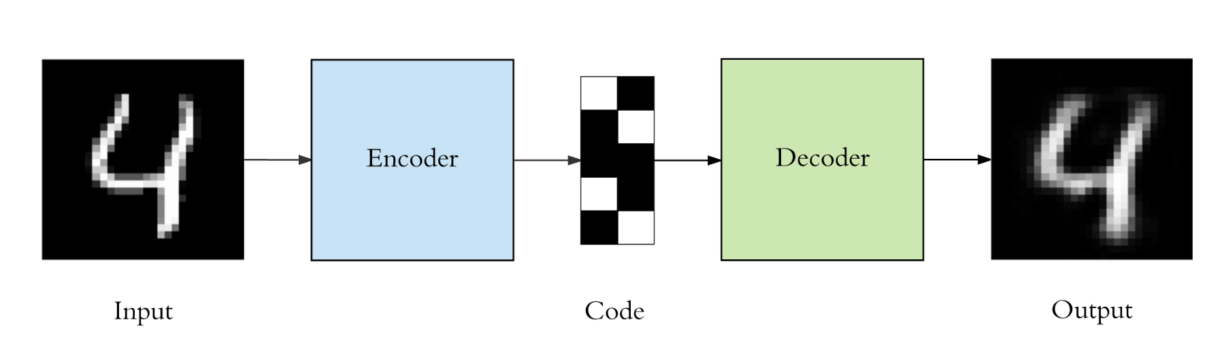
Neural Network Autoencoders
Autoencoder structure
Symmetric neural network where inputs = outputs
Encoder – Decoder system with a middle bottleneck layer for dimension reduction
Goal – Learn the intrinsic structure of the data by prioritizing the important information (code)
Key Assumption: Structure is different for nominal data vs anomalous data
Reconstruction error for anomalous data will be higher
bottleneck
Example Use Case
784
10
784
Notes:
One way to do this is using Neural Network autoencoders
Its an artificial neural network where the input data is identical to the output data.
Encoder - maps the inputs into a lower dimensional code
Decoder – aims to maps that encoding back into the original input with minimum error
Goal – learn the important information which represents the intrinsic structure in the data (code)

Slide 5
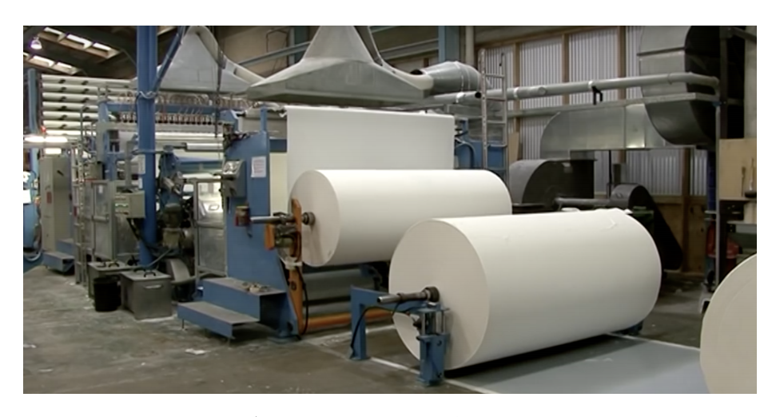
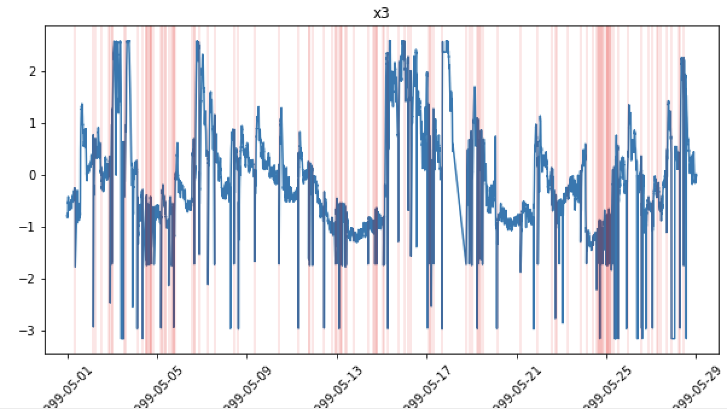
Open Source Dataset #1: Paper Mill Machine Sensors
https://arxiv.org/pdf/1809.10717.pdf
Data: Time series of paper mill machine with 60 sensor parameters and 1 binary target variable indicating failures
Failures represent when the machine breaks, breaks can take over 1 hour to resolve
Variables: Large class imbalance – 124 failure vs 18,274 non-failure points (failures in red)
Benchmark: In the paper, the best supervised model (XGBoost) had F1 score of .11
Sensor 3 out of 61
Notes:
The first thing I did was to find an open source dataset to try this model on.
Machine sensor data
Time series
Labeled failures with high class imbalance
Paper mill dataset where failures represent breakages
Large class imbalance
Best model had f1 score of .11

Slide 6
Simple Autoencoder for Paper Mill
Proposed Anomaly Detection Method
Train model on non-failure data
X = sensor inputs, y = sensor inputs
Set statistical threshold for nominal behavior based on training data's reconstruction error
try 3 sigma, 5 sigma, and max threshold
Predict on test data
Calculate reconstruction error for test data
Classify anomaly based on error threshold
Input – 61 sensors
Dense
(32 units)
Dense
(16 units)
bottleneck
Dense
(32 units)
Output – 61 sensors
Notes:
Left – network for the autoencoder
Right is the steps for anomaly detection
Train on non-failure data
Assess the reconstruction error of the training data to set a threshold for what normal behavior looks like
Predict on the test data and classify anomalies based on this threshold

Slide 7

Data Preprocessing – Autoencoder
CSV file
Drop non-sensor variables
Binary target variable padding
Standard scaler
Train/test split
Allow for early prediction intervals
Train = 90% of non-failures
Test = 10% of non-failures and 100% of failures

Slide 8
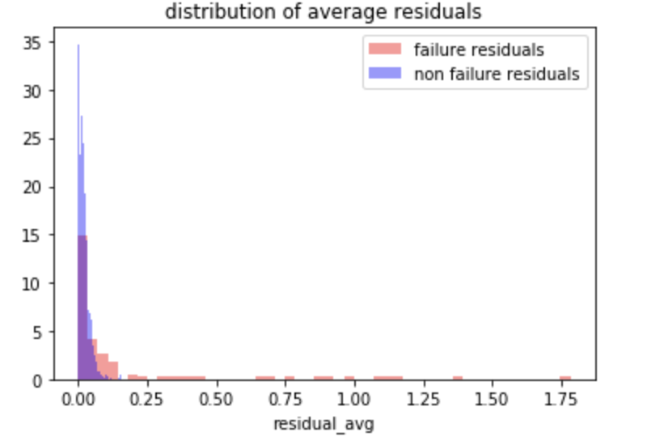
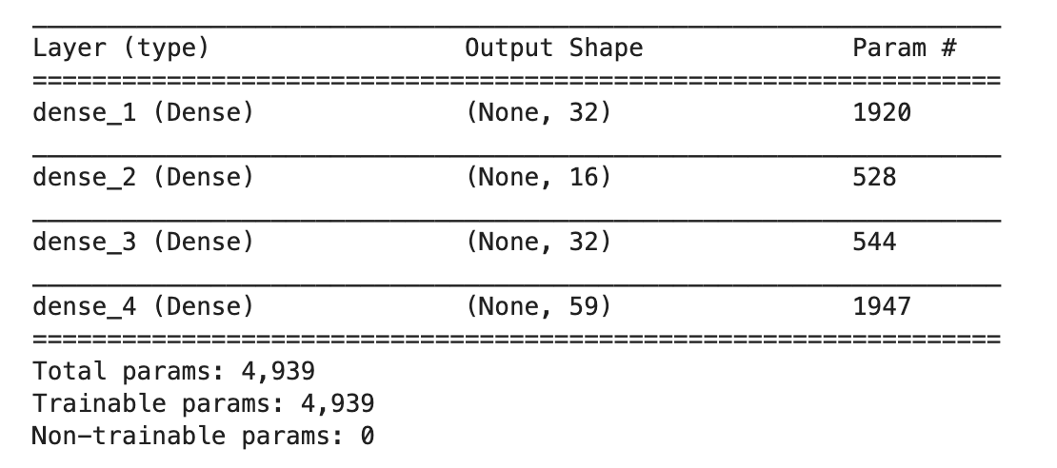
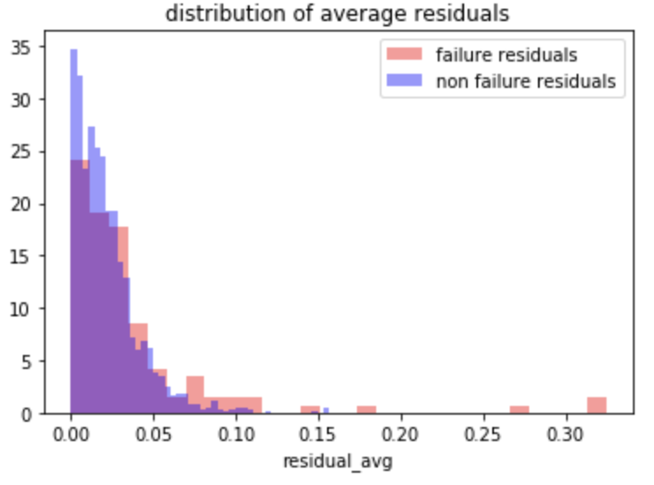
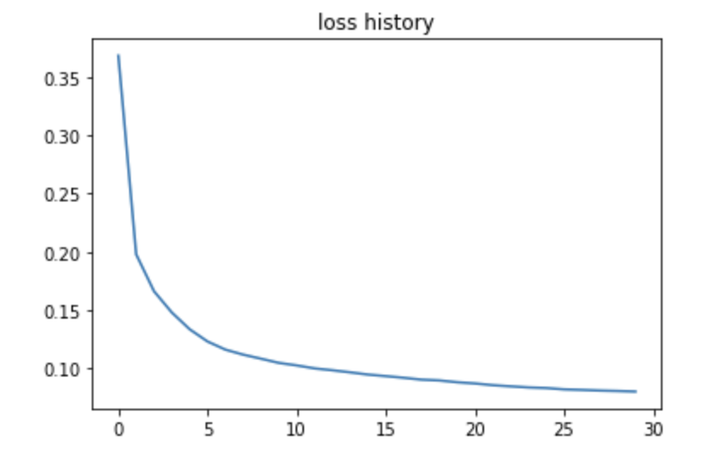
Preliminary Results
Reconstruction Error
Autoencoder weights – 5K params
Non failures
Failure – early interval = 1
Loss Curve
Failure – early interval = 2
Training time = 1 second per epoch
Early interval = 1 shows better separation of failures
Notes:
Preliminary results
Model converges decently
Histogram of reconstruction error – red = failures and blue is non failures
Top graph is early interval of 1 which means predicting one timepoint before failure

Slide 9
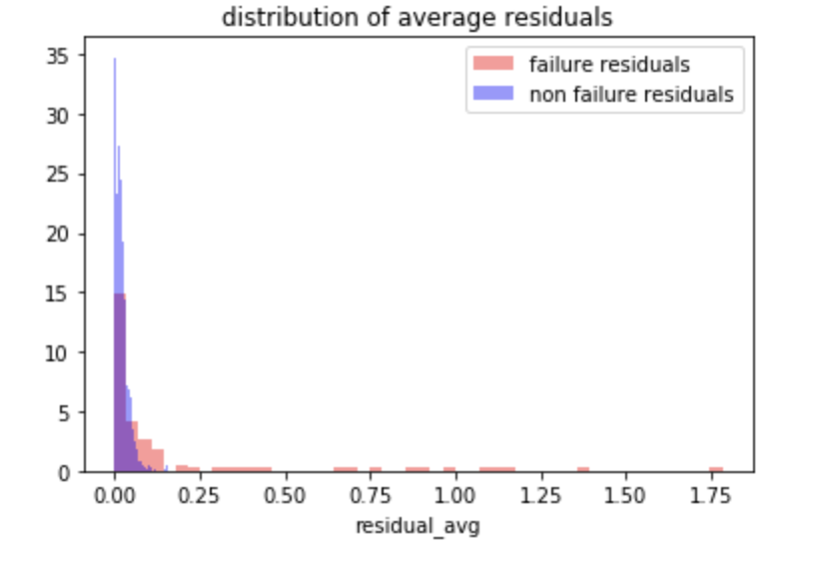
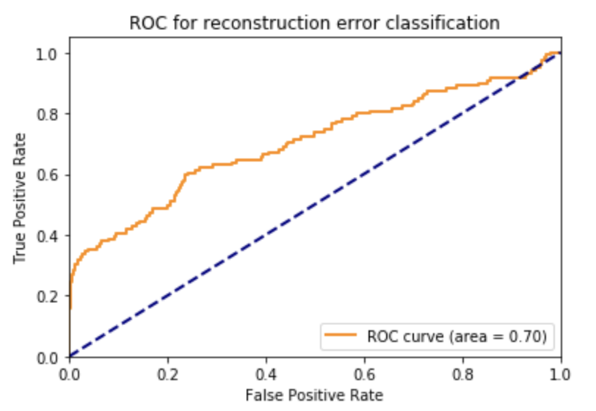
Comparison to XGBoost
Test Residuals
Threshold 3s
Failures
Thresholds calculated based on training data – 3 and 5 sigma
Perform classification based on threshold
Early prediction interval = 1
 | XGBoost (Paper) | 3σ threshold | 5σ threshold
Topology | NA | 32-16-32 | 32-16-32
Precision | .51 | .554 | .84
Recall | .07 | .303 | .218
F1 Score | .11 | .391 | .347
ROC AUC | Not provided | .70
Autoencoders handles class imbalance better than XGB for this dataset
Notes:
How our model compares to XGBoost to predict failures 1 timestep before.
We assessed 2 thresholds for an anomaly – 3 sigma and 5 sigma and we found that overall our model performs significantly better
Its a very difficult dataset to predict failures but our model was able to have a higher precision, recall, f1 score with a roc auc of .70

Slide 10
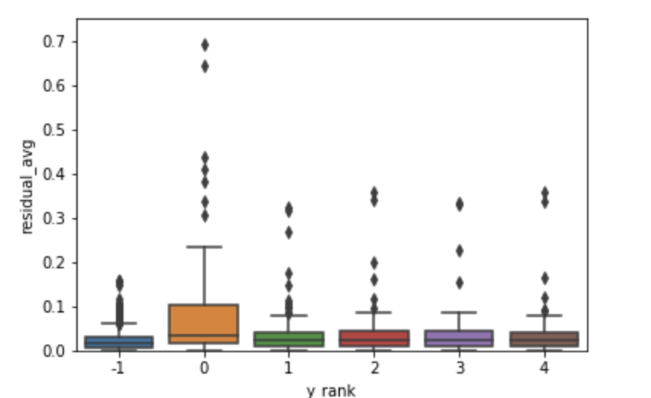
Residual distribution vs early prediction interval
Error distribution for early intervals
 | Early 1 | Early 2 | Early 3
Topology | 32-16-32 | 32-16-32 | 32-16-32
Precision | .554 | .293 | .216
Recall | .303 | .98 | .065
F1 Score | .391 | .147 | .1
ROC AUC | .70 | .60 | .60
Non
failures
Early = 1
Early = 2
Early = 3
Early = 4
Early = 5
Autoencoder’s capability deteriorates as early interval increases
Notes:
Look at how far in advance our model can predict the anomaly.
On the left we have a boxplot where the y axis is reconstruction error and the x axis represents the early interval for our predictions.
We want the failures to stand out from the non-failures – and you can see for an early interval of 1 we have some distinct differences. And this corresponds to an AUC of .7
As we increase our early interval, our predictive capability goes down which is expected for the most part.

Slide 11
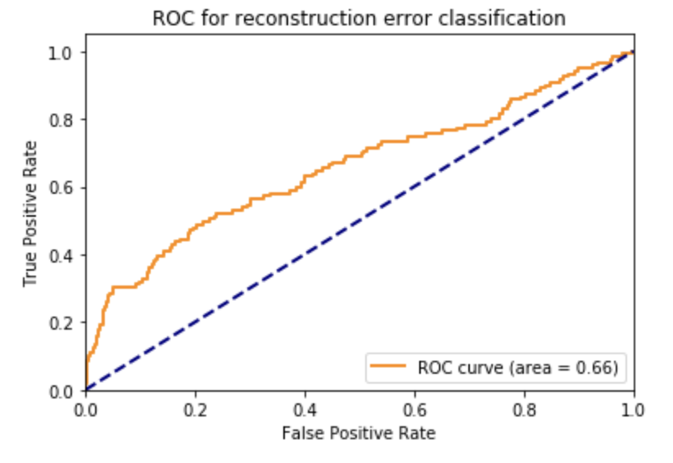
Different Feature Comparison
All 61 features
Threshold = 3 sigma training error
Early prediction interval = 1
Batch size = 12
Epochs = 50
Topology = tune for each feature set
Hidden Layer Shape | All features - 59 | Top 15 XGBoost Features
Topology | 32-16-32 | 12-6-12
Precision | .554 | .519
Recall | .303 | .118
F1 Score | .391 | .192
ROC AUC | .70 | .66
Top 15 features
Preliminary Feature selection did not improve model

Slide 12
Different Topology comparison
Threshold = 3 sigma training error
Early prediction interval = 1
Batch size = 12
Epochs = 50
Topology | Complex | Base Case | Simple
Topology | 32-16-8-16-32 | 32-16-32 | 16
Precision | .682 | .554 | .655
Recall | .252 | .303 | .15
F1 Score | .368 | .391 | .257
ROC AUC | .68 | .70 | .65
3 Layer auto encoder performed the best
Performance hovers around ~.68 AUC

Slide 13
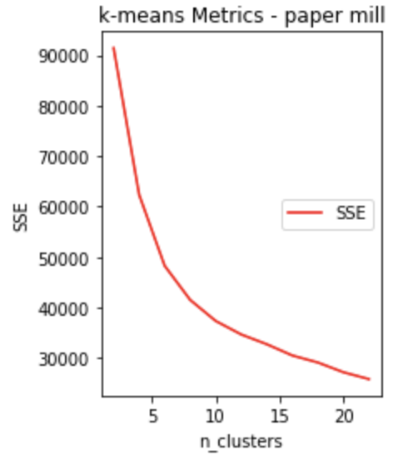
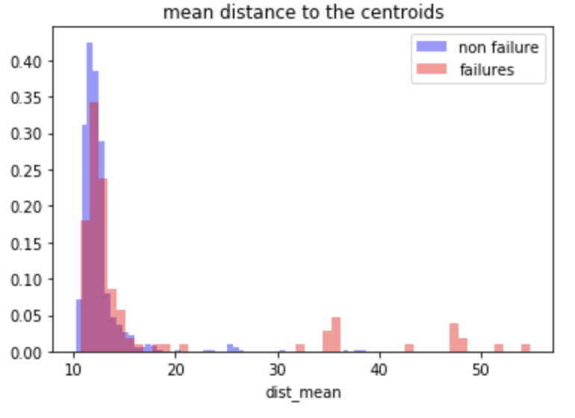
Comparison to K means clustering anomaly detection
Step 1: Chose 5 clusters based on SSE elbow plot
Step 2: Fit clusters on train data (non-failures)
Step 3: Obtain L2 distances to 5 centroids for test data
Step 3: Find mean distance to centroids
Step 4: Classify based on 3 sigma threshold for mean distance based on training data
Early prediction interval = 1
Early Interval = 1 | Autoencoder – 61 variables | Km - sensor inputs - 61 variables | Km - encoded outputs
Precision | .554 | .447 | .098
Recall | .303 | .176 | .034
F1 Score | .391 | .253 | .05
ROC AUC | .70 | .58 | .51
K means on raw inputs sets a baseline for performance
Combination of K means on encoded data performed poorly

Slide 14
Additional K-means comparison results
Auto encoders vs K means for all variables and XGBoost selected variables
Auto encoders vs K means for raw sensor inputs vs encoded sensor inputs
Early Interval = 1 | Autoencoder 61 variables | Km - sensors 61 variables | Km - encoded 61 Variables | Autoencoder 15 Variables | Km - sensors 15 variables | Km - encoded 15 Variables
Precision | .554 | .447 | .098 | .519 | .122 | .067
Recall | .303 | .176 | .034 | .118 | .050 | .017
F1 Score | .391 | .253 | .05 | .192 | .071 | .027
ROC AUC | .70 | .58 | .51 | .66 | .51 | .501
K means on raw inputs sets a baseline for performance
Combination of K means on encoded data performed poorly

Slide 15
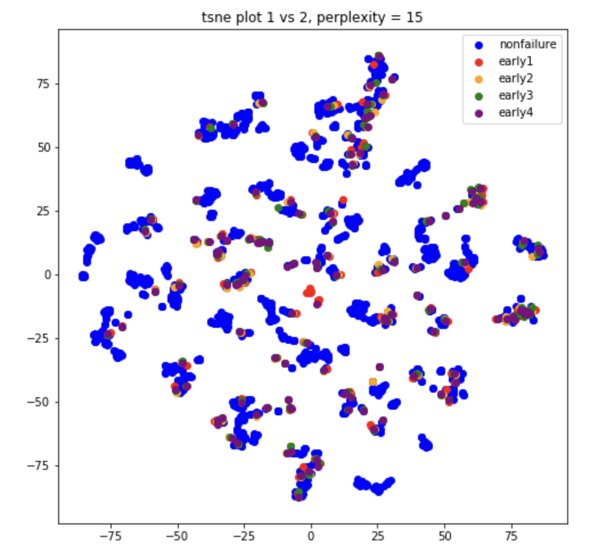
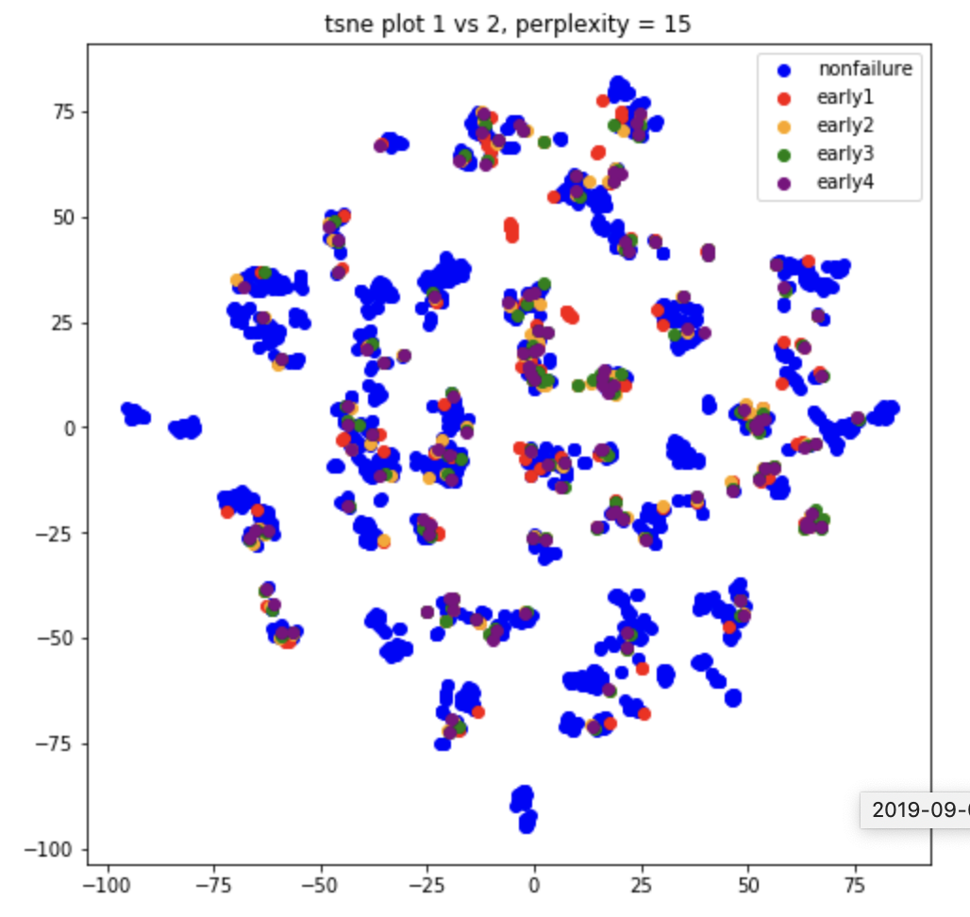
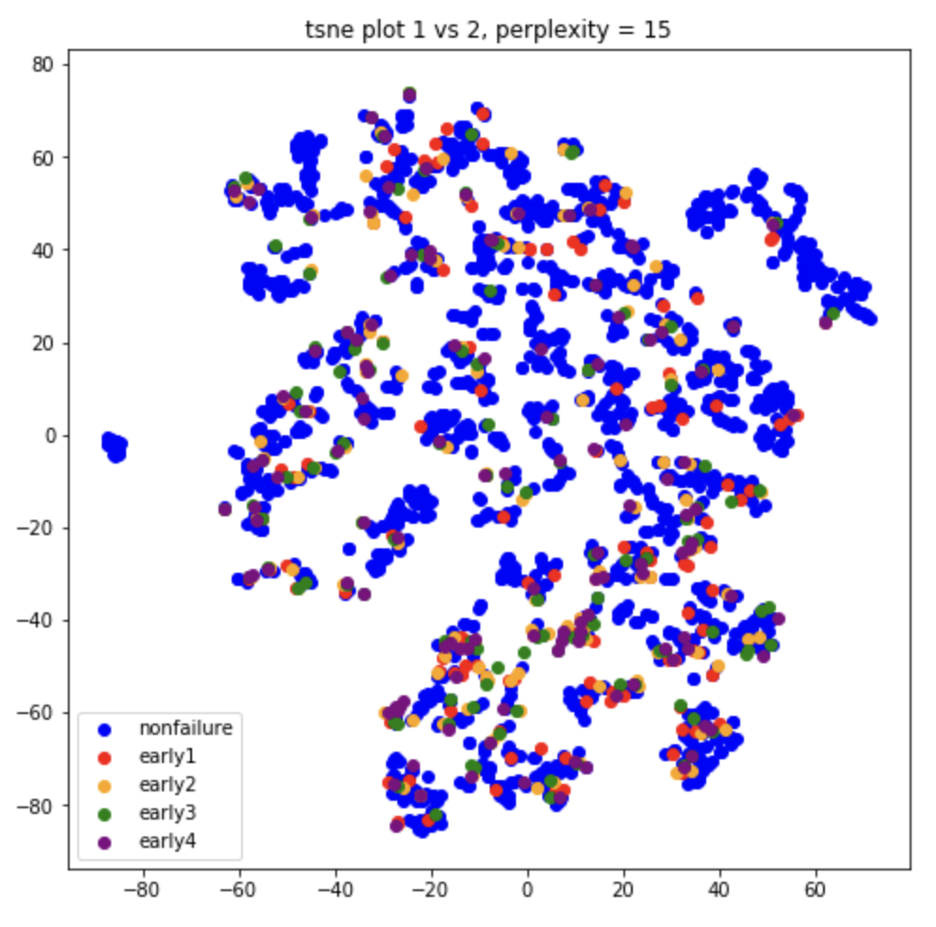
Visualization of encoded representation with t-sne
Sensor inputs
Encoded Data
Encoded Data – xgb selected features (top 15)
T-sne is not able to separate failures from non-failures

Slide 16
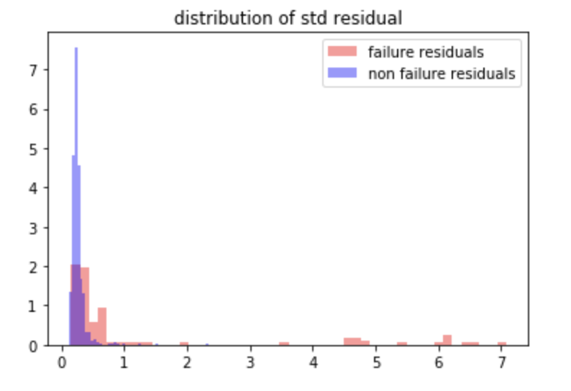
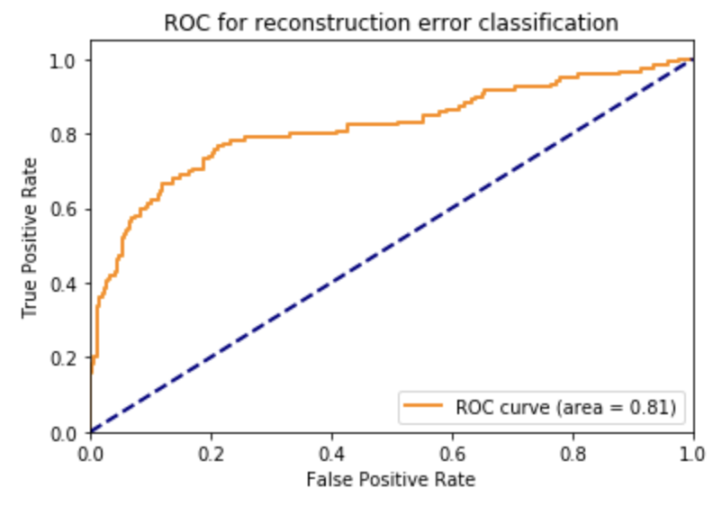
Using standard deviation to define reconstruction error
Step 2 is different
Train model on non-failure data
X = sensor inputs, y = sensor inputs
Reconstruction error = standard deviation of 61 errors
Set 3 sigma threshold for nominal data
Predict on test data
Calculate reconstruction error for test data
Classify anomaly based on error threshold
Early Interval = 1 | Autoencoder Mean error | Autoencoder std error
Precision | .554 | .671
Recall | .303 | .395
F1 Score | .391 | .497
ROC AUC | .70 | .81

Slide 18
Next Steps
Find Other Datasets
Benchmark against other datasets
Develop code base for reuse
Assess LSTM for anomaly detection
Find other ways to assess reconstruction errors
Apply to UTC use case

Slide 19
Appendix

